Slide 1
Converting Business Revenue Code into Rules for E-tracs 2.55

Slide 2
Rule-Engine
Business Rules uses a Rule-Engine
A Rule-Engine is an expert-system program, which runs the rules on the data and if any condition matches then it executes the corresponding actions

Slide 3

Rules
It is a set of conditions followed by the set of actions
It contains mainly two parts, condition, and action
The condition also knows as a fact or antecedents or patterns. And action also knows as a consequent.

Slide 4
Advantages of Rule-Engine
Reduced Complexity
It reduced the complexity as we no longer need to build the rule engine logic in the source
Reusability
By keeping rules in one place leads to greater reusability of your business rules

Slide 5
Business Ruleset
BP Billing Rules
Computes Surcharge and Interest
Determines the Quarterly Due Dates
Determines the Bill Expiry Date
Fire Assessment Rules
Computes fees related to BFP
BP Info Rules
Collects initial information to be used in the assessment rules
BP Requirement Rules
Determines the documents required in the application
BP Assessment Rules
Computes Tax, Regulatory Fees and Other Charges

Slide 6
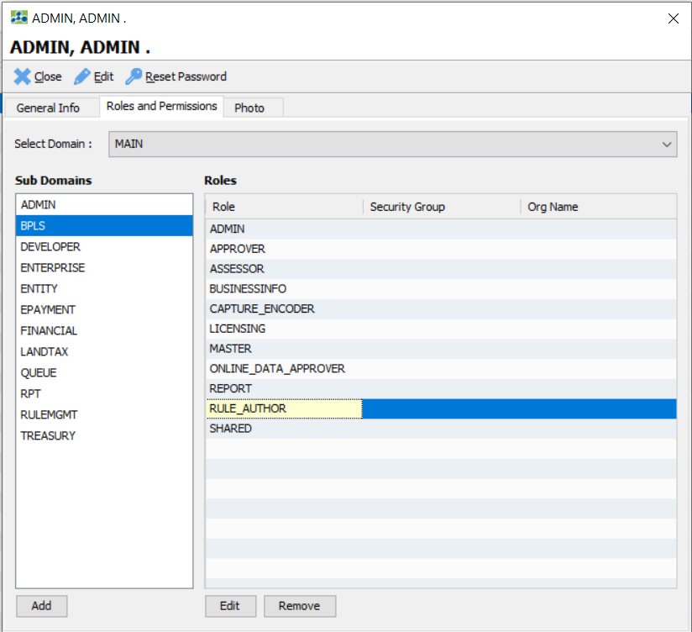
Steps in Creating Business Rules
Open e-tracs client.
Required role: BPLS.RULE_AUTHOR

Slide 7
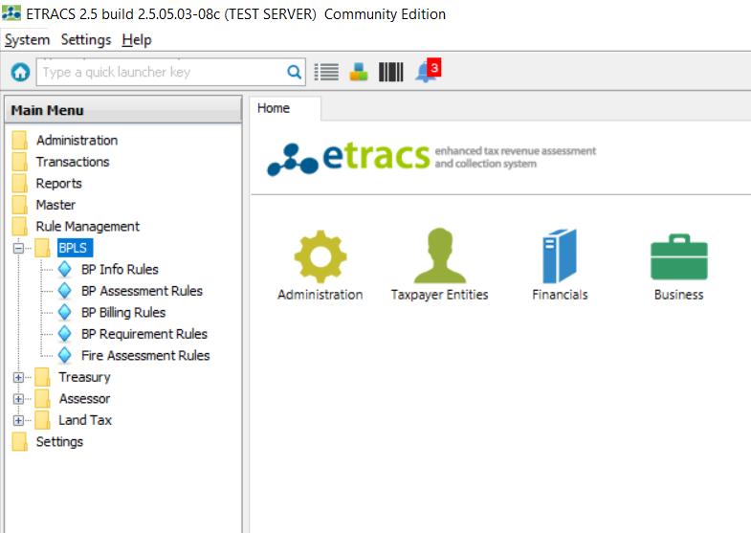
Go to Main Menu > Rule Management > BPLS

Slide 8
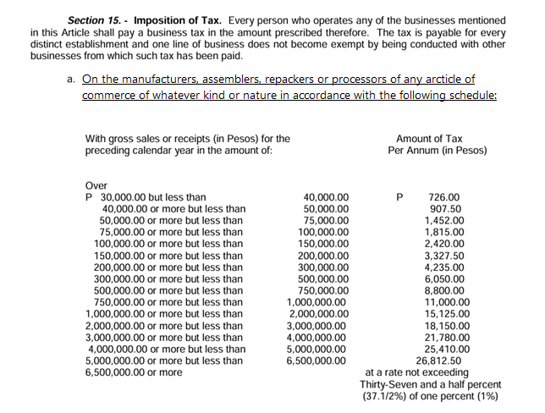
Business Tax Computation Rules
Let’s convert this computation of Municipal Business Tax into a rule.

Slide 9
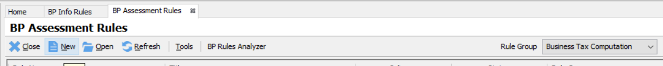
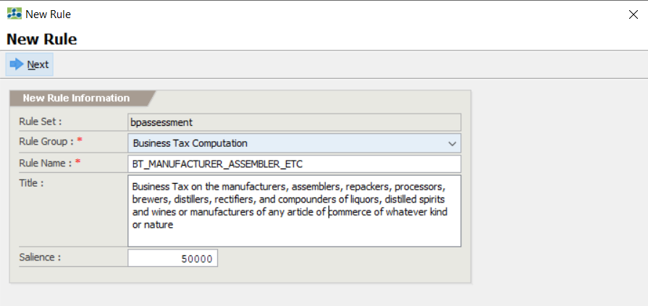
Business Tax Computation Rules
Go to BP Assessment Rules
Click on New icon
Business Tax Computation must be selected in the Rule Group

Slide 10
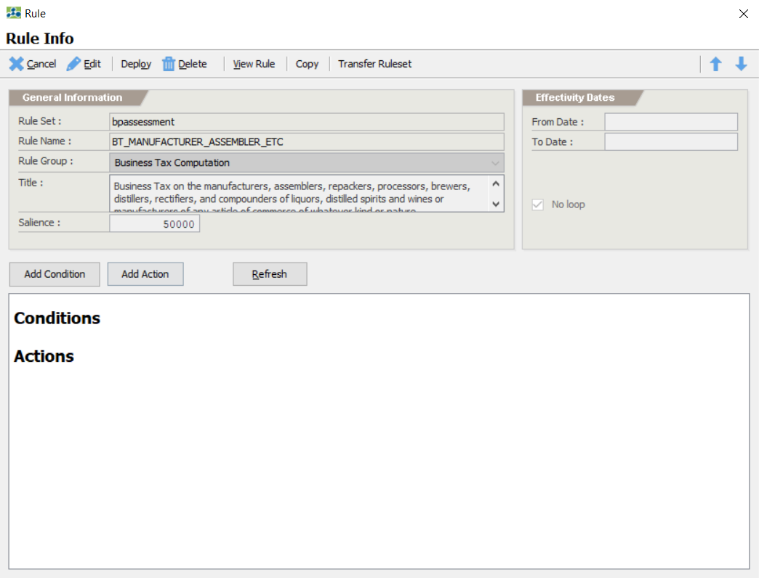
Business Tax Computation Rules
Add Condition and Actions:

Slide 11
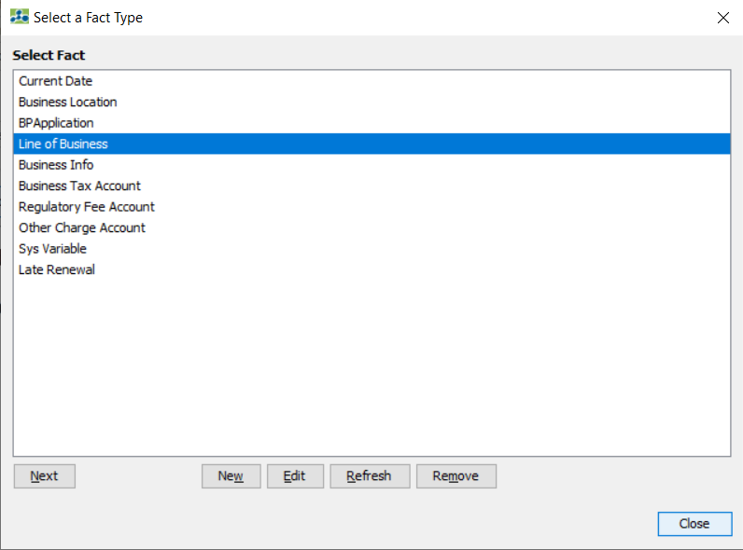
Business Tax Computation Rules
Add Condition and select a Fact Type, and click Next to proceed

Slide 12
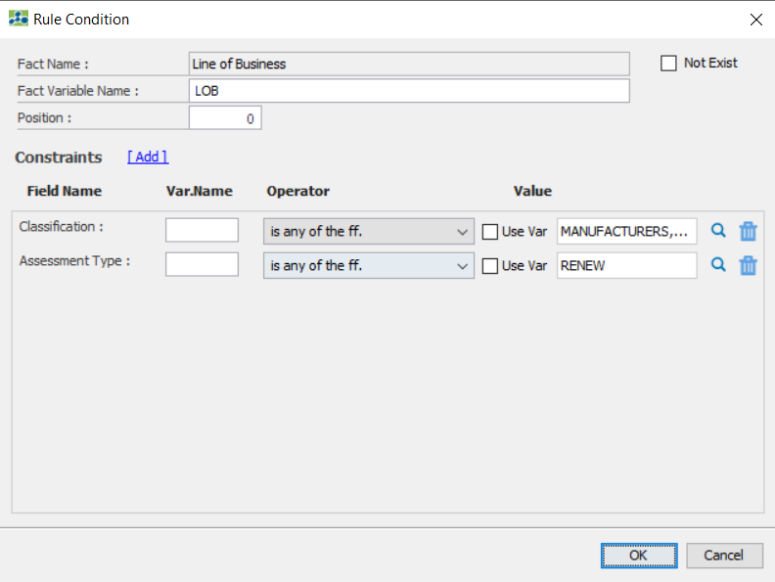
Business Tax Computation Rules
Add Contraints , select a Field.
Modify the values according to the rules to be set.

Slide 13
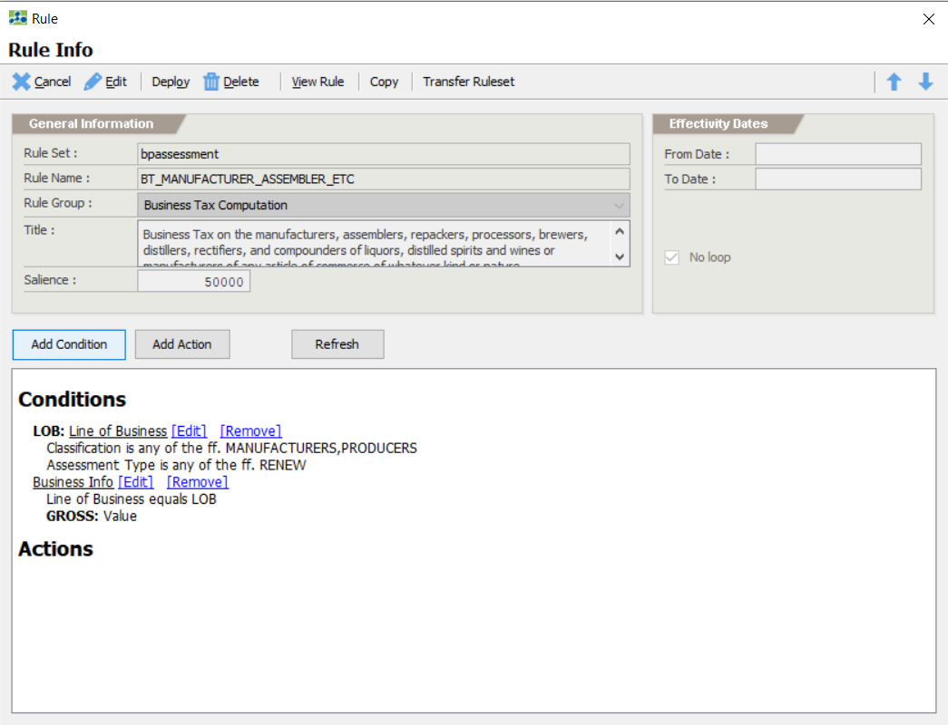
Business Tax Computation Rules
Add all the Conditions that apply to that specific rule and repeat the previous steps

Slide 14
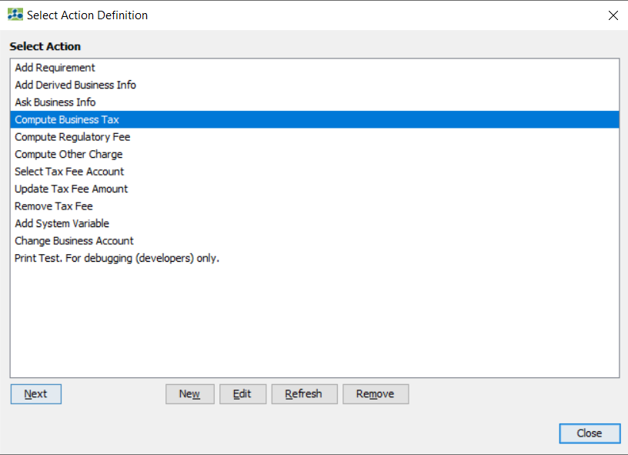
Business Tax Computation Rules
Add Actions, select the actions that will be performed whenever the conditions which were set earlier will be met.

Slide 15
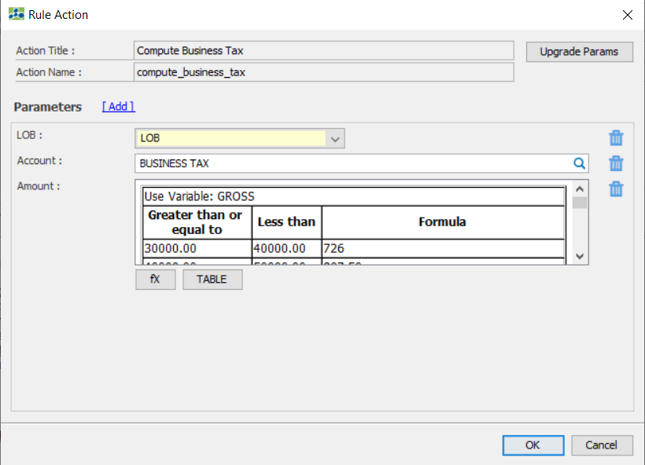
Business Tax Computation Rules
Add the Parameters.

Slide 16
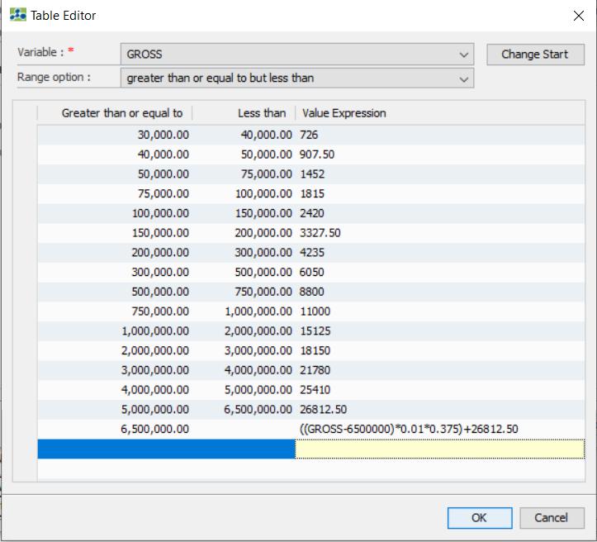
Business Tax Computation Rules
Amount Table Sample

Slide 17
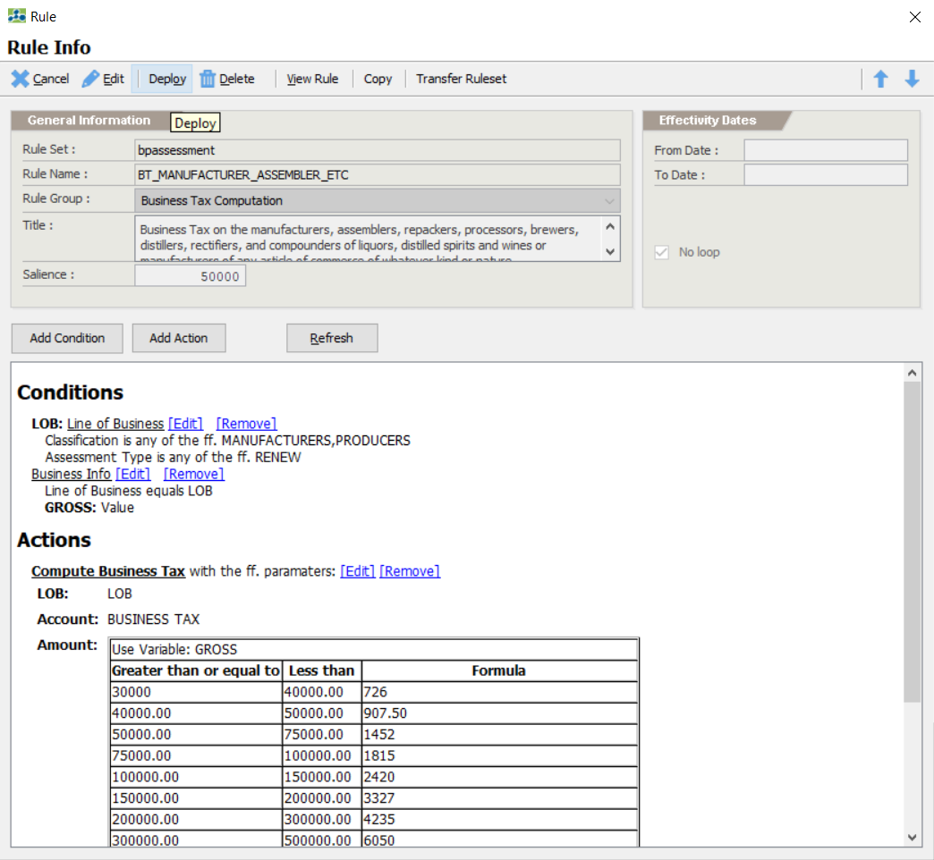
Business Tax Computation Rules
Deploy the Rule

Slide 18
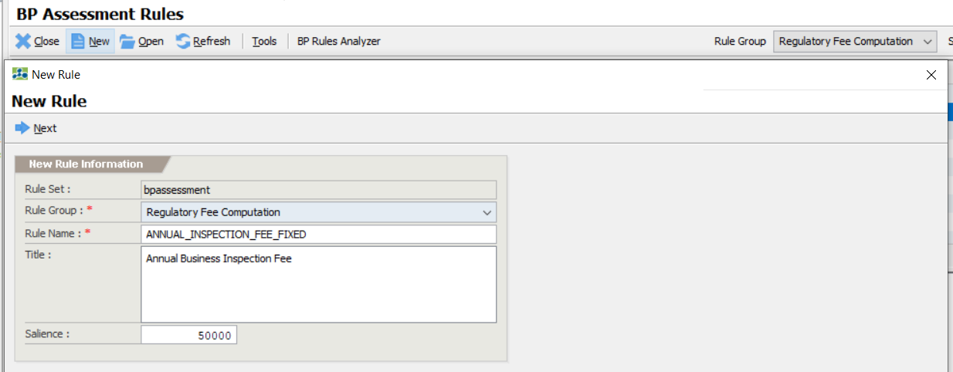
Regulatory Fee Computation Rules (Fixed Amount)
Go to BP Assessment Rules
Click on New icon
Regulatory Fee Computation must be selected in the Rule Group

Slide 19
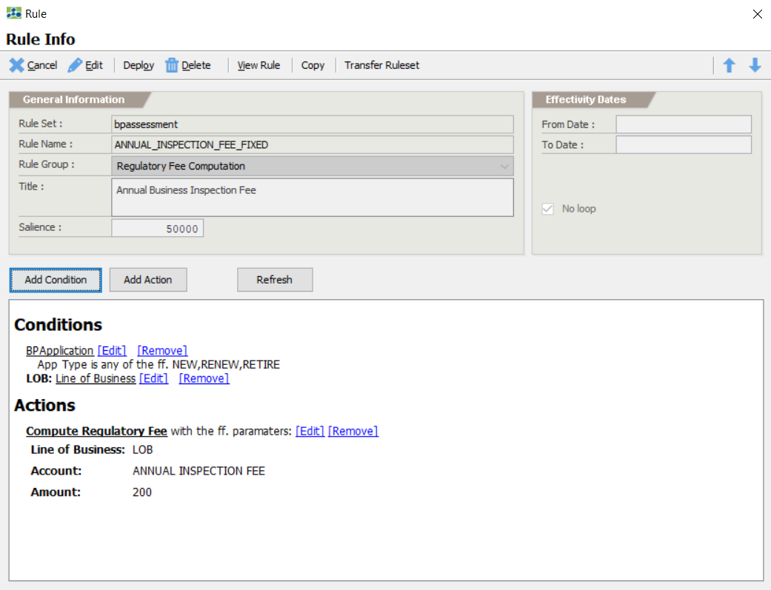
Regulatory Fee Computation Rules (Fixed Amount)
Add Conditions and Actions. Deploy the rule afterwards.

Slide 20
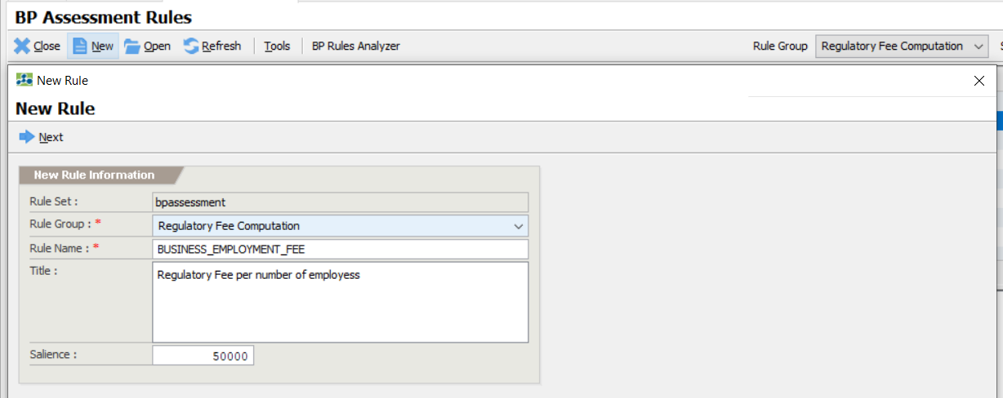
Regulatory Fee Computation Rules (Amount per Unit)
Go to BP Assessment Rules
Click on New icon
Regulatory Fee Computation must be selected in the Rule Group

Slide 21
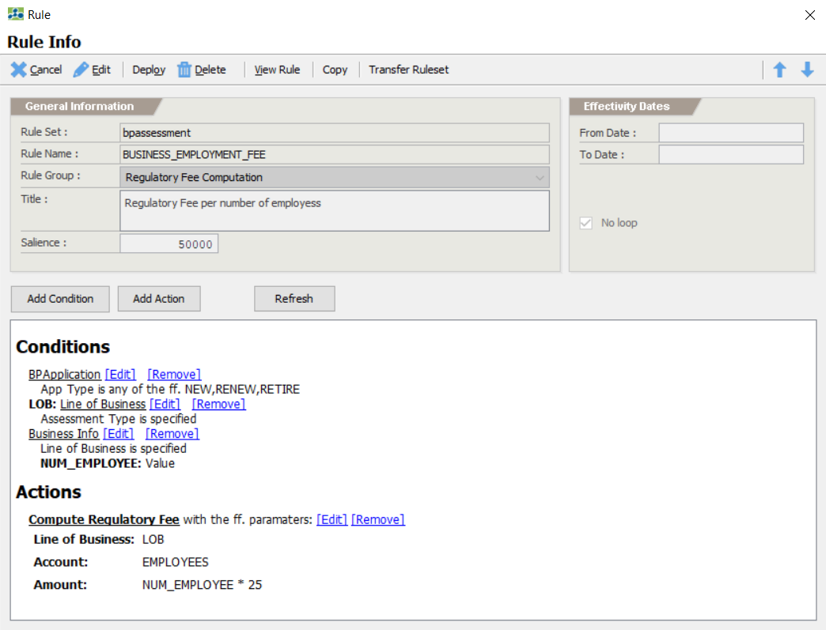
Regulatory Fee Computation Rules (Fixed Amount)
Add Conditions and Actions. Deploy the rule afterwards.

Slide 22
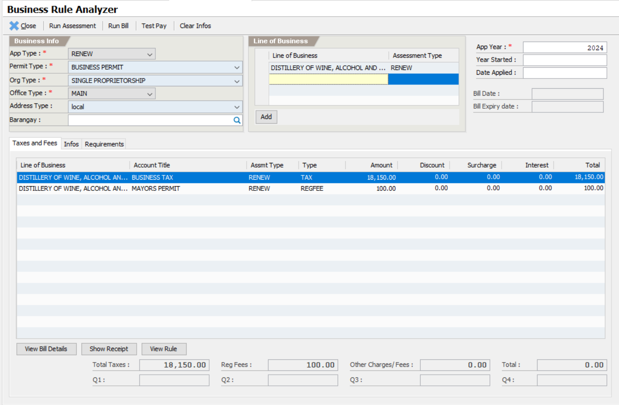
Business Tax Computation Rules
Test the Rules using BP Rule Analyzer

